Slide 1
Single-cell Multi-omics Data Integration through Deep Learning
TAC meeting spring 2021
Chaozhong Liu
Supervisor: Dr. Zhandong Liu
Program: Quantitative and Computational Biosciences

Slide 2
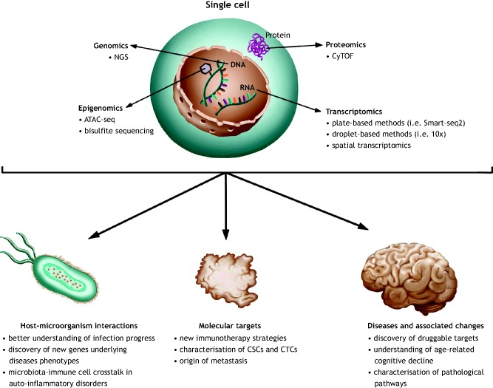
Single-cell techniques are driving the study of diseases
Higher resolution at single-cell level:
Heterogeneity in cell behavior
Associate disease with cell types
Tracing the origin of abnormal cells
Precise target for treatment
……
Paulina M. Strzelecka, et al. 2018. Dis Model Mech

Slide 3
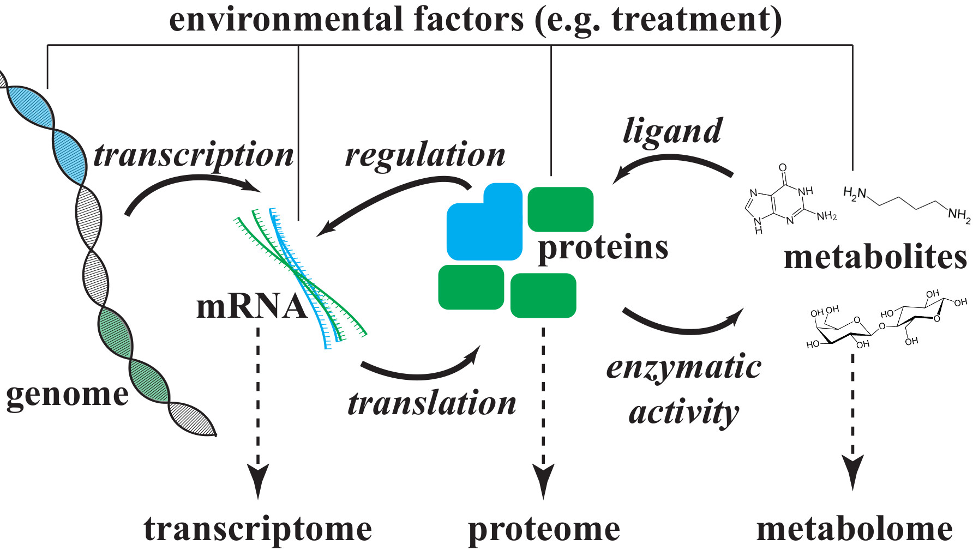
Understanding cellular processes through the integration of multi-omics data
The ambiguity of interactions makes it clear that measuring the system at a single level gives only limited insight into the structure and function of the cellular processes.
An integration view is needed at single-cell level.
https://www.blopig.com/blog/2017/03/multiomics-data-analysis/

Slide 4
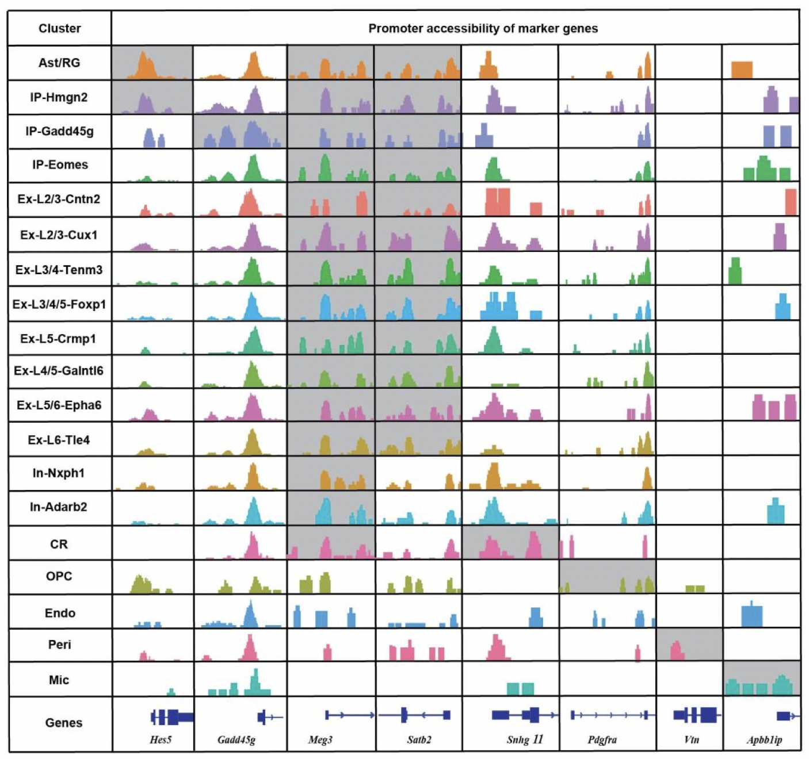
Inter-play exists among different omics
https://www.blopig.com/blog/2017/03/multiomics-data-analysis/
Reference: Song Chen, et al. High-throughput sequencing of the transcriptome and chromatin accessibility in the same cell. Nat Biotechnol 37(12):1452-1457 (2019).

Slide 5
Inter-play exists among different omics
scATAC-seq
snRNA-seq
Chromatin Accessibility
Transcriptome
Promoter
~
Gene expression
To what extent can the promoter accessibility explain the gene expression?
Reference: Song Chen, et al. High-throughput sequencing of the transcriptome and chromatin accessibility in the same cell. Nat Biotechnol 37(12):1452-1457 (2019).

Slide 6
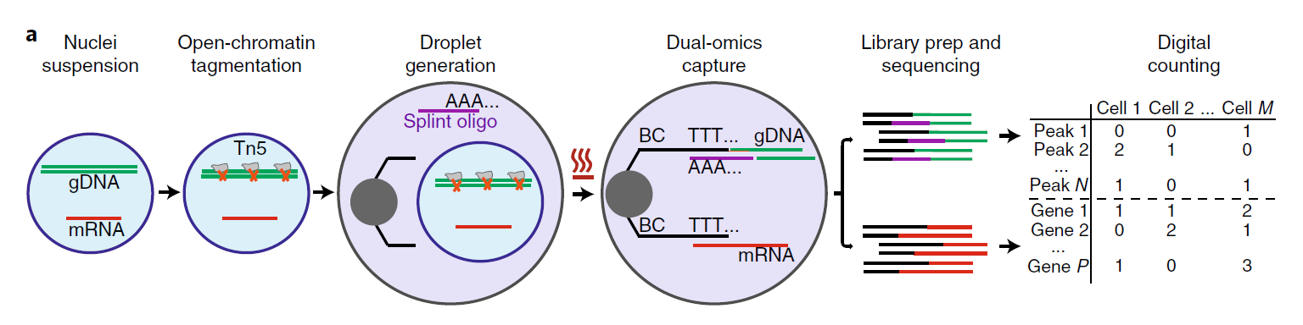
Benchmark dataset to evaluate the correlation
SNARE-seq technique measures expression and chromatin accessibility simultaneously.
snATAC-seq
snRNA-seq
Song Chen, et al. 2019. Nature Biotechnology.
In one cell, does a more open promoter region indicate a higher gene expression?
Reference: Song Chen, et al. High-throughput sequencing of the transcriptome and chromatin accessibility in the same cell. Nat Biotechnol 37(12):1452-1457 (2019).

Slide 7
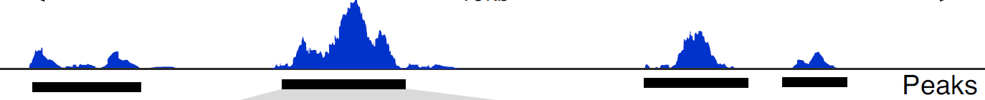
Promoter accessibility shows weak correlation with gene expression
Promoter accessibility:
3kb upstream of TSS
scATAC-seq
Peaks 1
Peaks 2
Peaks 3
Peaks 4
3kb
Gene X promoter
Peak 1 + Peak 2
Gene X
Notes:
Flip the figure 3
Choose a different example
Challenge 2: correlation is not suitable here

Slide 8
Promoter accessibility shows weak correlation with gene expression
True Pair Ranks
Correlation between one cell and all other cells
Calculate the correlation rank of true pairs
Summarize all the true pair ranks

Slide 9
Inter-play exists among different omics
scATAC-seq
snRNA-seq
Chromatin Accessibility
Transcriptome
Promoter
~
Gene expression
Enhancer - Promoter
~
Gene expression
Unknow interaction
~
Gene expression
Reference: Song Chen, et al. High-throughput sequencing of the transcriptome and chromatin accessibility in the same cell. Nat Biotechnol 37(12):1452-1457 (2019).

Slide 10
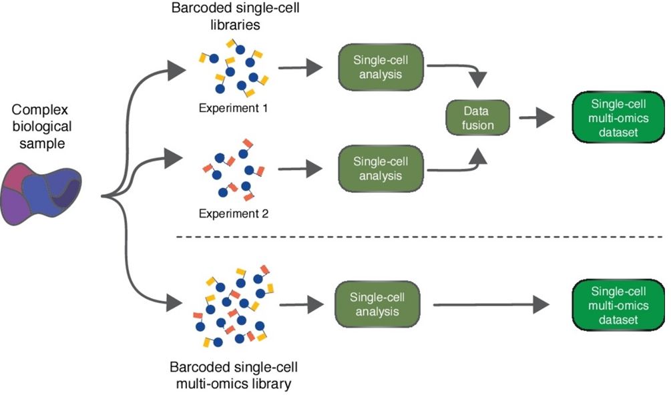
Two main branches of methods
Computational Approaches
Experimental Approaches
(High cost and low depth)
Karolis Leonavicius, et al. 2019. Current Opinion in Genetics & Development

Slide 11
Description of the problem
Input: scMulti-omics datasets
Output: integrated dataset
features 1
cells 1
meta-features
Computational Approaches
identity
features 2
cells 2
Identity: cells, cell types, clusters, etc.
Meta-features: original features, new features, etc.

Slide 12
Description of the problem
Unmatched cells
features 1
cells
features 2
cells

Slide 13
Description of the problem
Unmatched cells
features 1
features 2
cells

Slide 14
Description of the problem
Unmatched cells
features 1
cells 1
features 2
cells 2

Slide 15
Description of the problem
Unmatched cells
features 1
cells 1
Aligning cells between datasets (which cells are similar based on features)
features 2
cells 2

Slide 16
Description of the problem
Unmatched cells
features 1
cells 1
Aligning cells between datasets (which cells are similar based on features)
Features are totally different
features 2
cells 2

Slide 17
Description of the problem
Unmatched cells
Mapping features
features 1
features 2
cells 1
cells 1
features 2
features 2
cells 2
cells 2

Slide 18
Seurat and Liger
Unmatched cells
Mapping features
peaks
genes
scATAC-seq
cells 1
cells 1
Peaks 1
Peaks 2
genes
genes
3kb
Gene X promoter
cells 2
cells 2
Peaks 1 + Peaks 2
Gene X

Slide 19
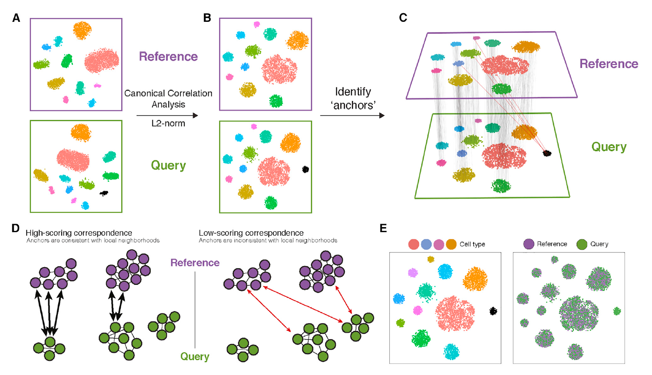
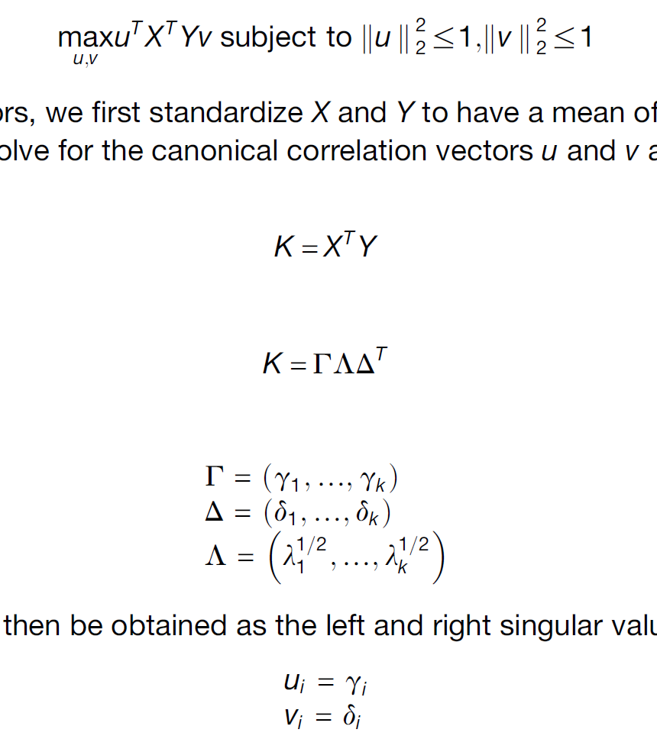
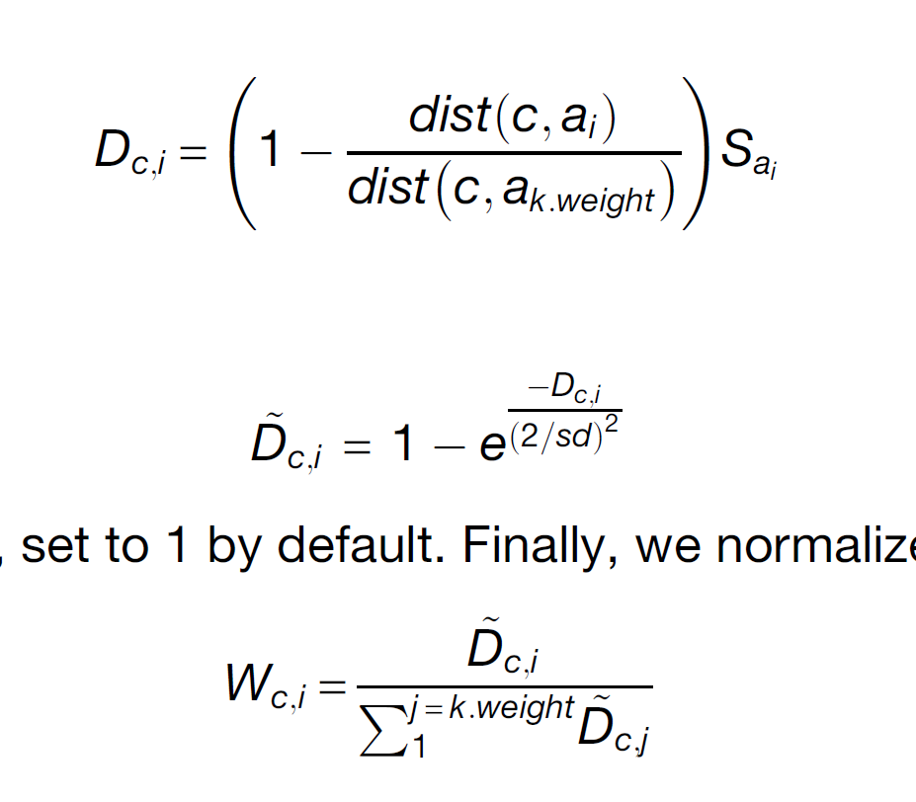
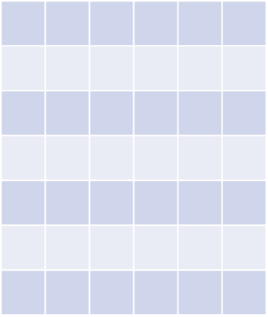
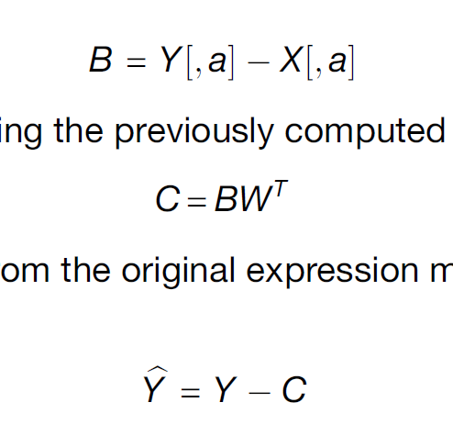
Seurat v3 (CCA + MNN)
A
B
C
Ref –
RNA-seq
Genes
Query – ATAC-seq
MNN to find anchors
Filter anchor, got anchor score Sai
D
Calculate Weight Matrix
E
F
Datasets fusion
Anchors
W
Query Cells
Label transfer
Data fusion
Reference: Tim Stuart, et al. Comprehensive Integration of Single-Cell Data. Cell 177, 1888–1902 (2019).

Slide 20
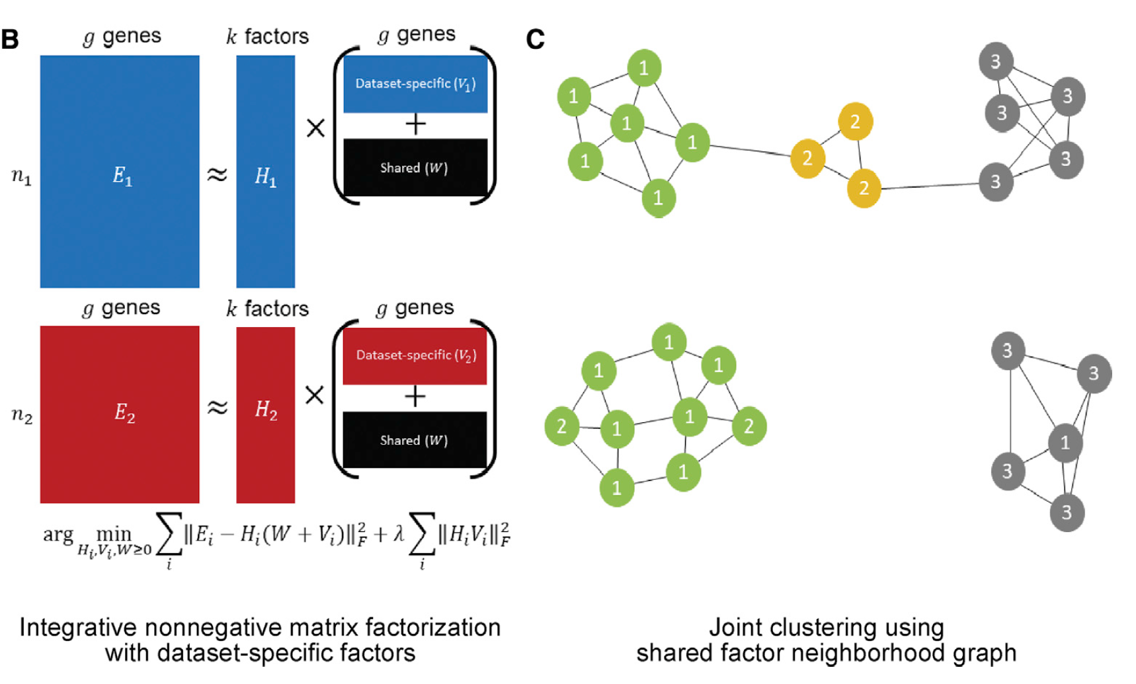
Liger (iNMF + SFN)
A
B
C
2
1
2
3
2
i
1
3
3
FN(i): (0, 2, 1, 0)
Manhattan distance
Clustering by Louvain community detection
2
1
2
j
2
3
1
3
3
FN(j): (1, 2, 0, 0)
KNN graph
SNF graph
Reference: Joshua D. Welch, et al. Single-Cell Multi-omic Integration Compares and Contrasts Features of Brain Cell Identity. Cell 177, 1873–1887 (2019).

Slide 21
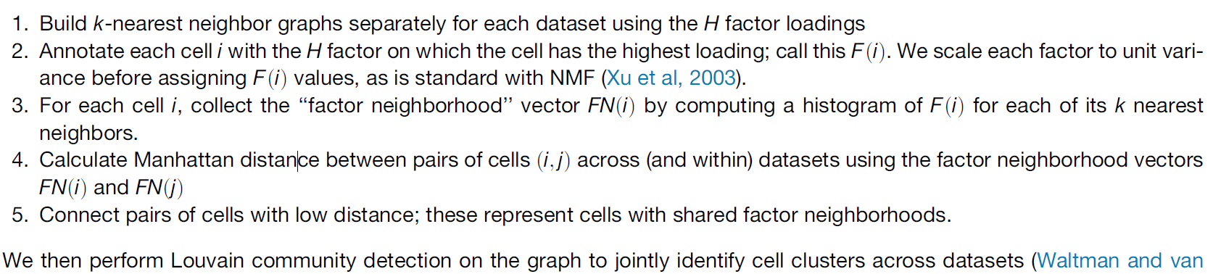
Liger (iNMF + SFN)
Penalty to avoid dataset-specific result

Slide 22
Empirical mapping shows little correlation between modalities
A
B
C
Peaks 1
Peaks 2
Peaks 3
Peaks 4
3kb
Gene X promoter
Peaks 1 + Peaks 2 = Gene X activity
*Peak 3 and 4 are excluded
D
E
F

Slide 23
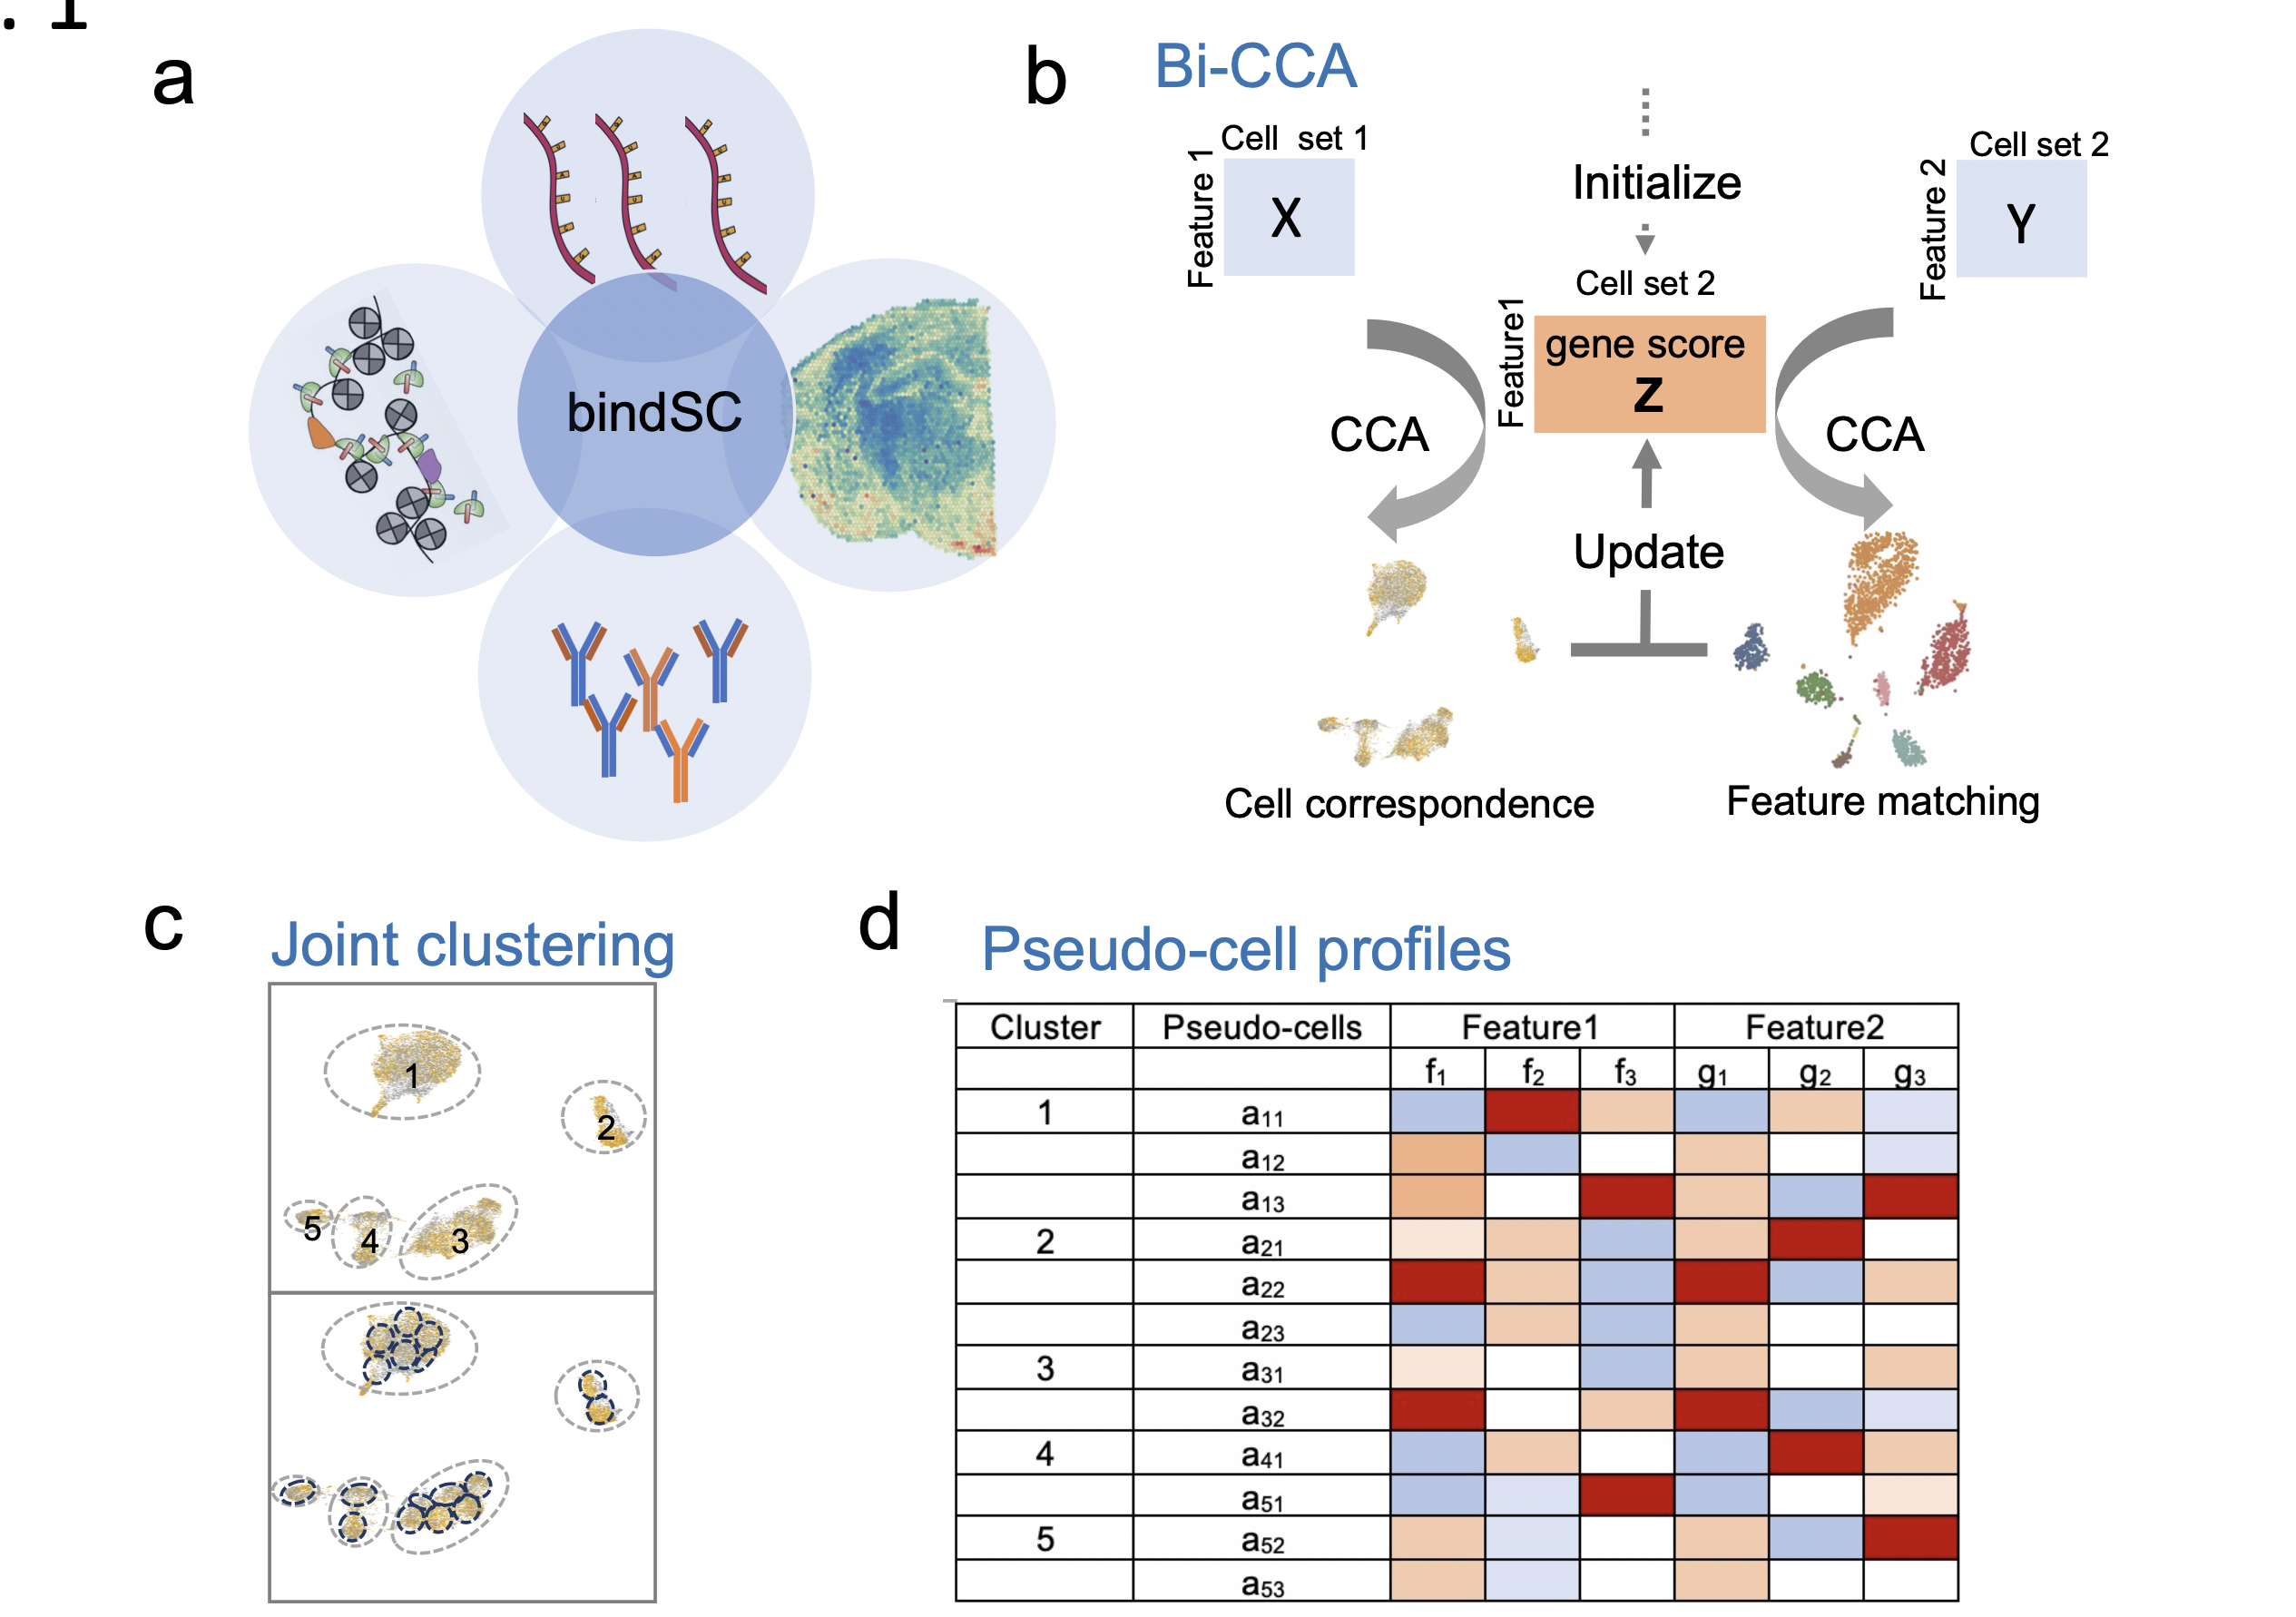
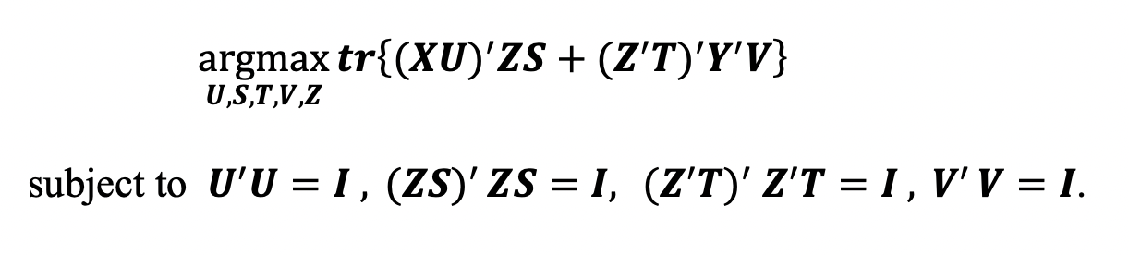
bindSC
A
B
C
Reference: Jinzhuang Dou, et al. Unbiased integration of single cell multi-omics data. bioRxiv 2020.12.11.422014 (2020).

Slide 24
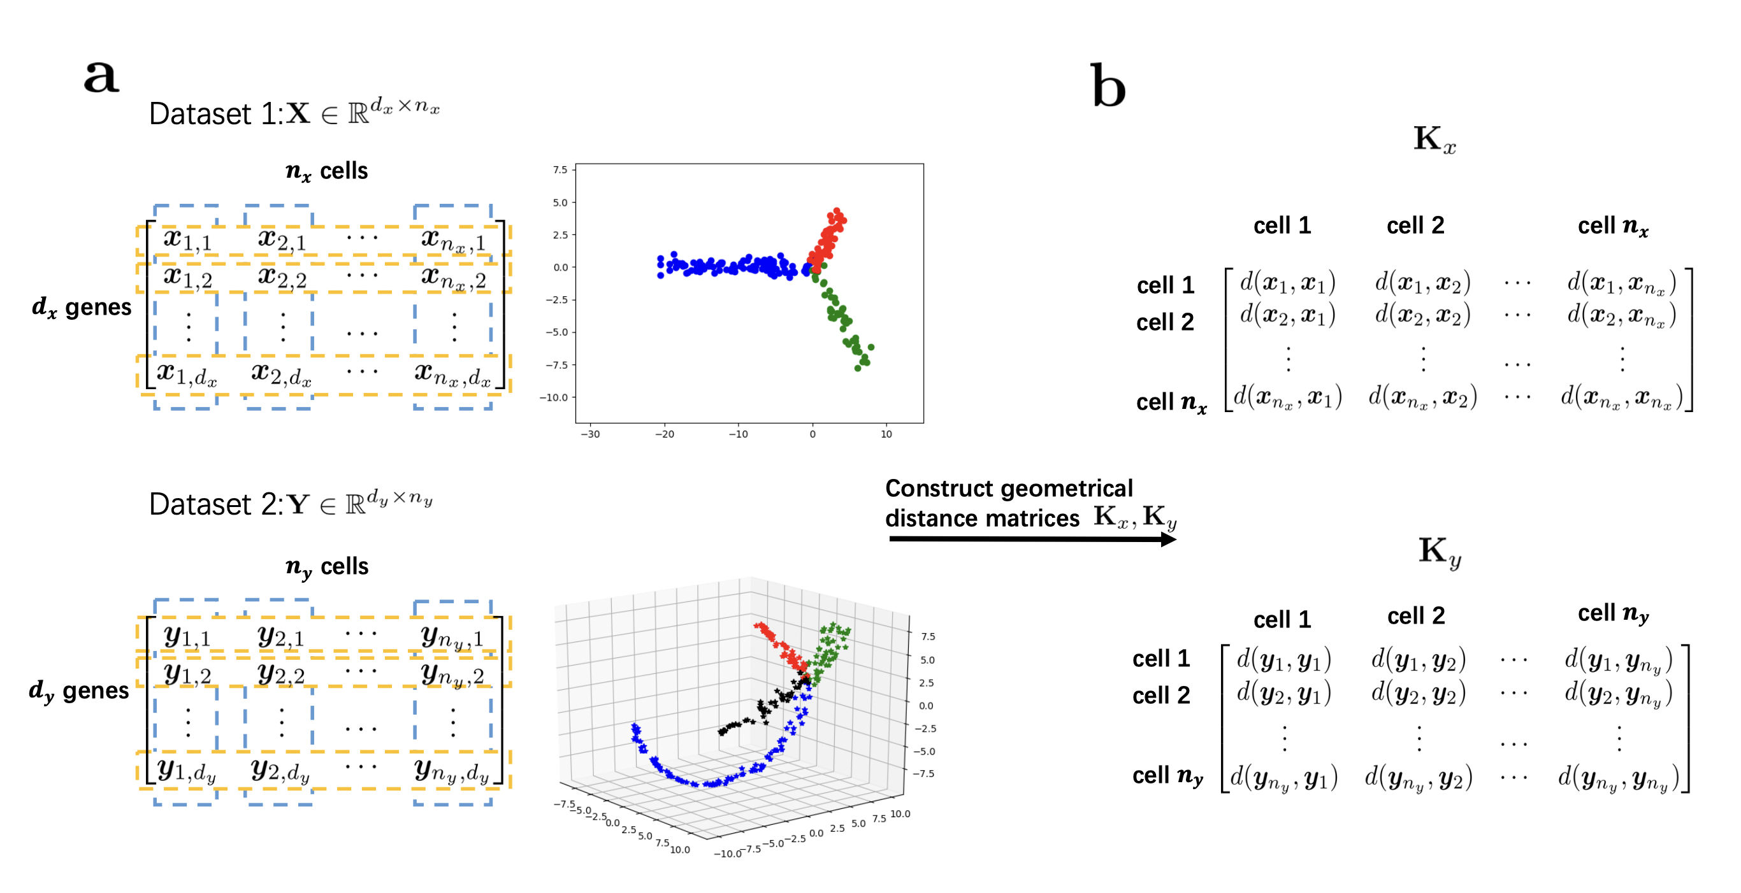
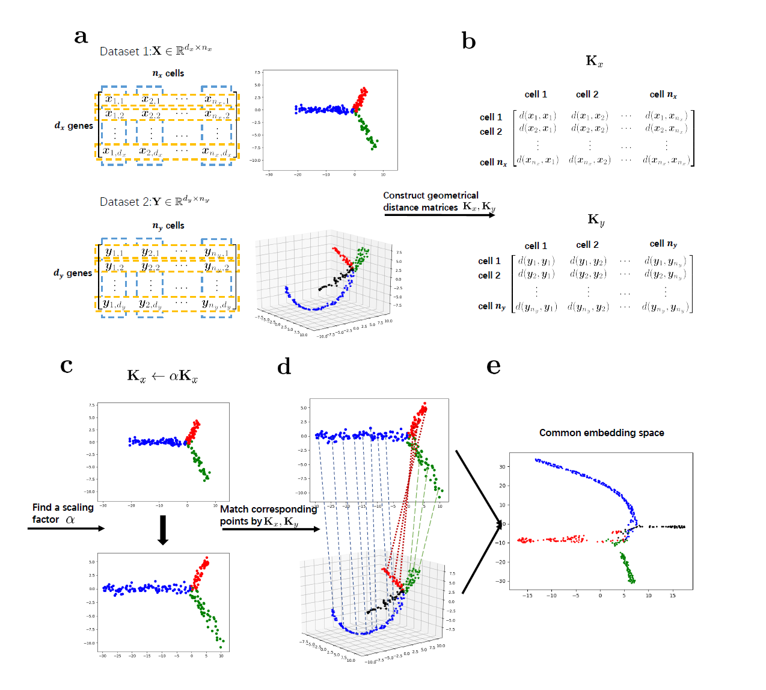
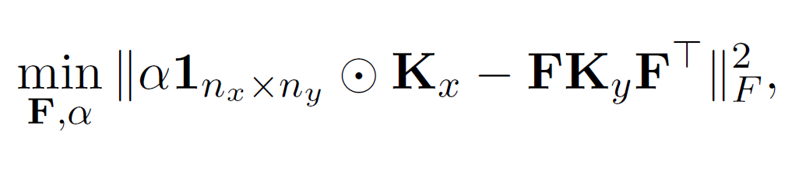
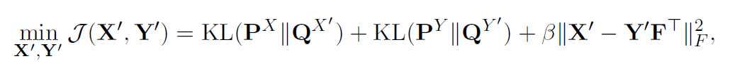
UnionCom (Topological Alignment)
A
B
C
D
t-SNE
Distance penalty
Reference: Kai Cao, et al. Unsupervised topological alignment for single-cell multi-omics integration. Bioinformatics 36, i48-i56 (2020).

Slide 25
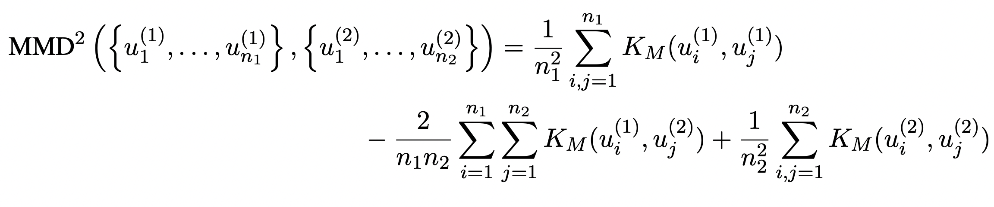
MMD-MA
Maximum mean discrepancy-based manifold alignment
Objective Function
i. MMD
Reference: Ritambhara Singh, et al. Unsupervised manifold alignment for single-cell multi-omics data. bioRxiv 2020. 06. 13. 149195 (2020).

Slide 26
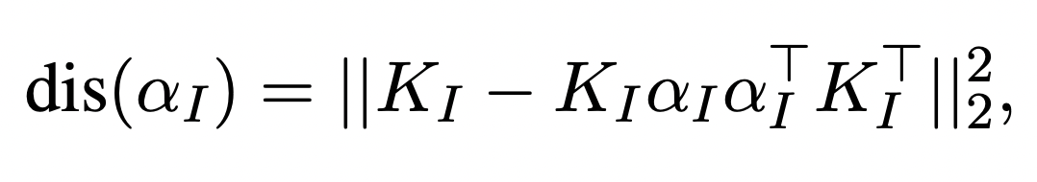
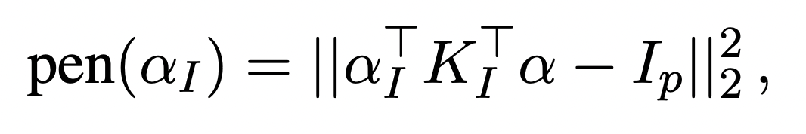
MMD-MA
Maximum mean discrepancy-based manifold alignment
Objective Function
ii. Distortion between the input space and the latent space
iii. Avoiding collapse to a trivial solution
Reference: Ritambhara Singh, et al. Unsupervised manifold alignment for single-cell multi-omics data. bioRxiv 2020. 06. 13. 149195 (2020).

Slide 27
Gaps to fill
Integration is not learning or informed by feature mapping.
Integration is absent from the downstream inter-play analysis.
Input: scMulti-omics datasets
Output: integrated dataset
features 1
cells 1
meta-features
Computational Approaches
identity
features 2
cells 2
Identity: cells, cell types, clusters, etc.
Meta-features: original features, new features, etc.

Slide 28
Hypothesis
With well-designed deep learning model, the machine can learn the complex feature mapping between omics data while performing the integration task.
To build an interpretable deep learning model that can
Perform integration between single-cell omics data
Learn the feature mapping between omics
Be easily interpreted to extract the inter-play between omics

Slide 29
Aims of the thesis project
Build a neural network to integrate single-cell multi-omics dataset
Develop bioinformatics tool to extract biological features from the neural network and perform downstream analysis
Dissect the interplay of epigenome and transcriptome during Alzheimer’s Disease Progression using single cell multi-omics data

Slide 30
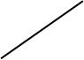
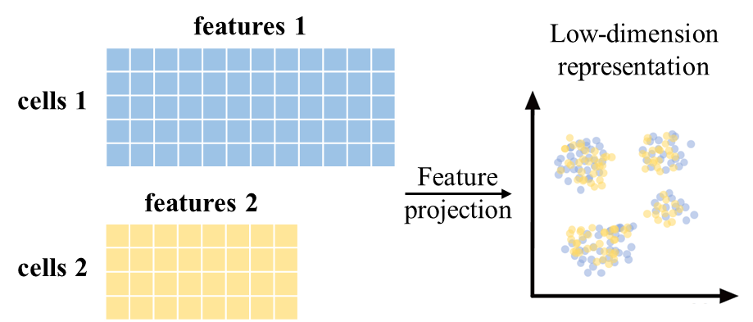
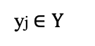
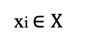
Architecture of the baseline neural network
Scenario
Neural network architecture
scOmics X
scOmics Y
xi $∈X$
Label Classifier
X
Label loss
Encoder X
xi’
yj $∈Y$
Encoder
Negative pair
Anchor pair
Domain Discriminator
Domain loss
Encoder Y
yj’
(Domain = Modality)

Slide 31
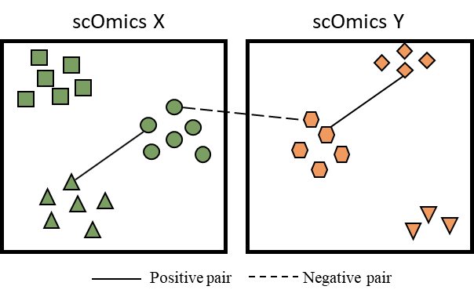
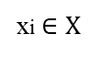
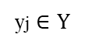
Strategies to make the NN unsupervised
Architecture of the neural network
True Label
xi $∈X$
Label Classifier
X
Label loss
Cell types
Encoder X
xi’
yj $∈Y$
Encoder
Negative pair: cells from different cell types
Anchor pair: cells that are similar
Domain Discriminator
Domain loss
Encoder Y
yj’

Slide 32
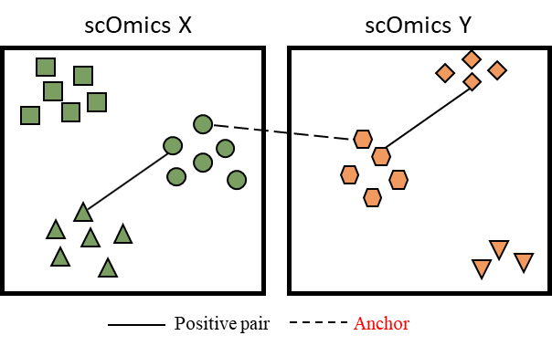
Strategies to make the NN unsupervised
Architecture of the neural network
True Label
xi $∈X$
Label Classifier
X
Label loss
Cell types
Clusters
Encoder X
xi’
yj $∈Y$
Encoder
Negative pair: cells from different clusters
Anchor pair: unsupervised algorithm to define similar cells / anchors (CCA+MNN)
Domain Discriminator
Domain loss
Encoder Y
yj’
AMANDA: Alignment of scMulti-Omics by Adversarial Network that Discriminates Anchors

Slide 33
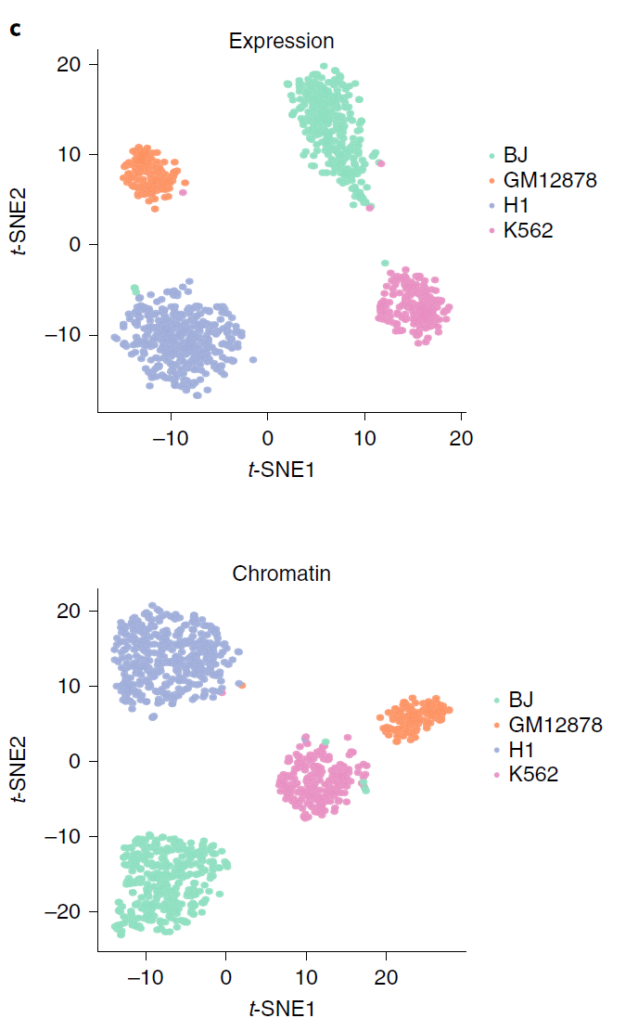
Benchmark dataset to evaluate the performance
SNARE-seq technique measures expression and chromatin accessibility simultaneously.
snATAC-seq
snRNA-seq
Song Chen, et al. 2019. Nature Biotechnology.
Cultured human BJ, H1, K562, and GM12878 cells
Reference: Song Chen, et al. High-throughput sequencing of the transcriptome and chromatin accessibility in the same cell. Nat Biotechnol 37(12):1452-1457 (2019).

Slide 34
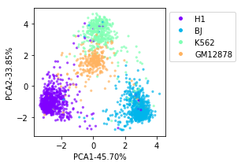
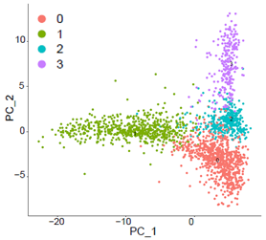
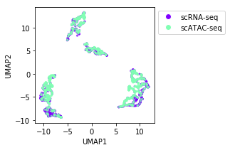
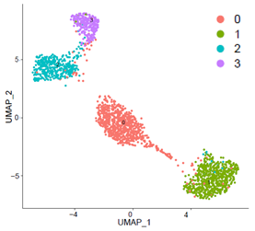
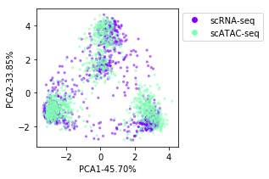
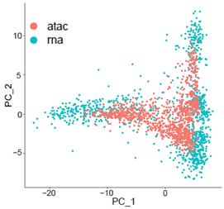
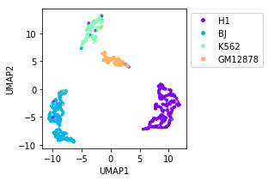
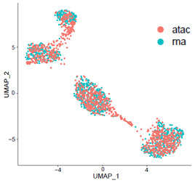
Current results
2-D co-embedded space generated by AMANDA and Seurat
(A) PCA
(B) UMAP
AMANDA
Seurat
AMANDA
Seurat

Slide 35
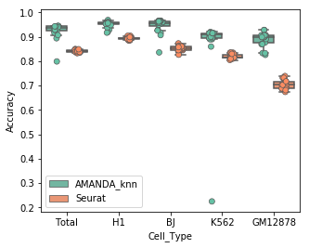
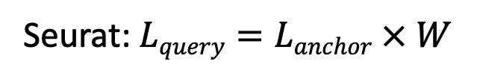
Current results
Label transfer accuracy
Transfer the cluster labels from scRNA-seq to scATAC-seq based on integration
Seurat: $Lquery=Lanchor × W$
AMANDA: max vote of K-nearest neighbor's label

Slide 36
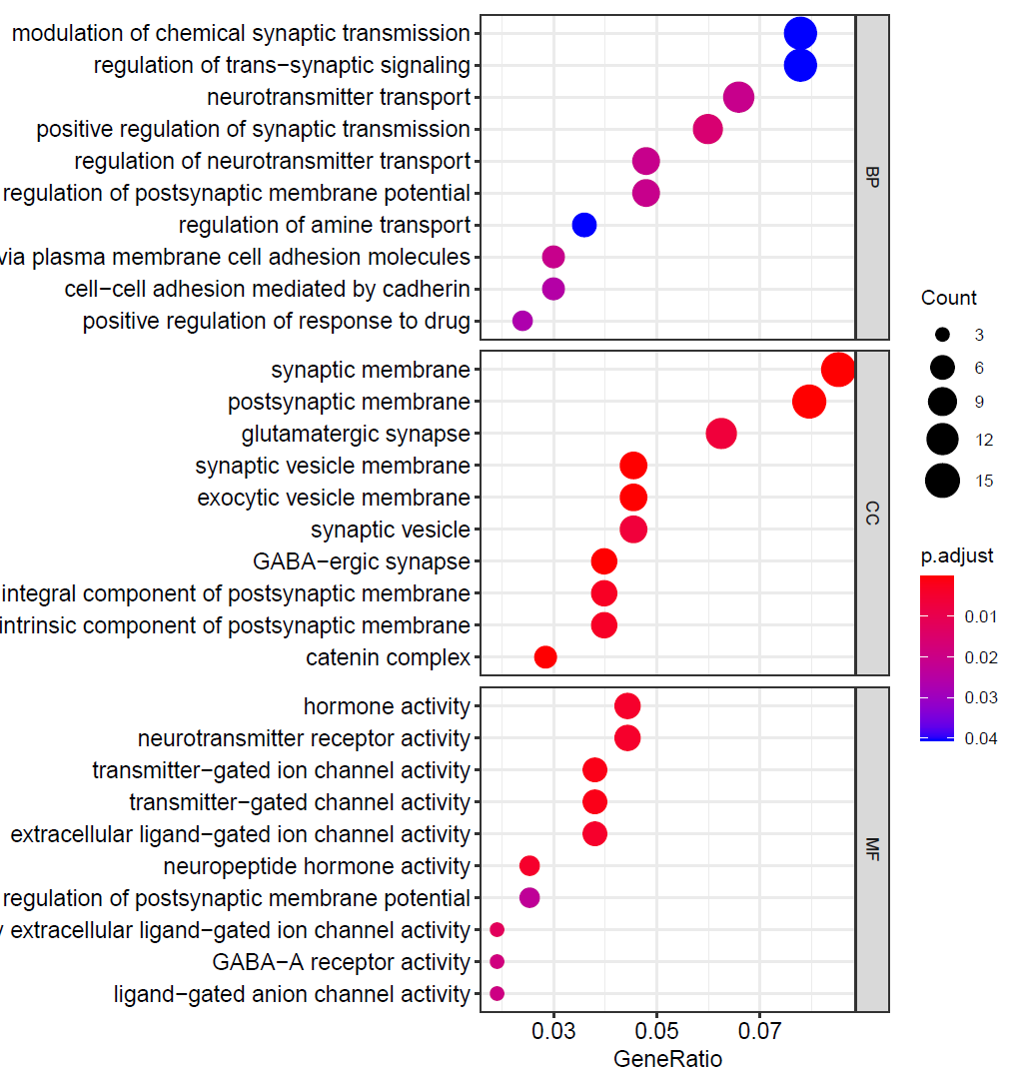
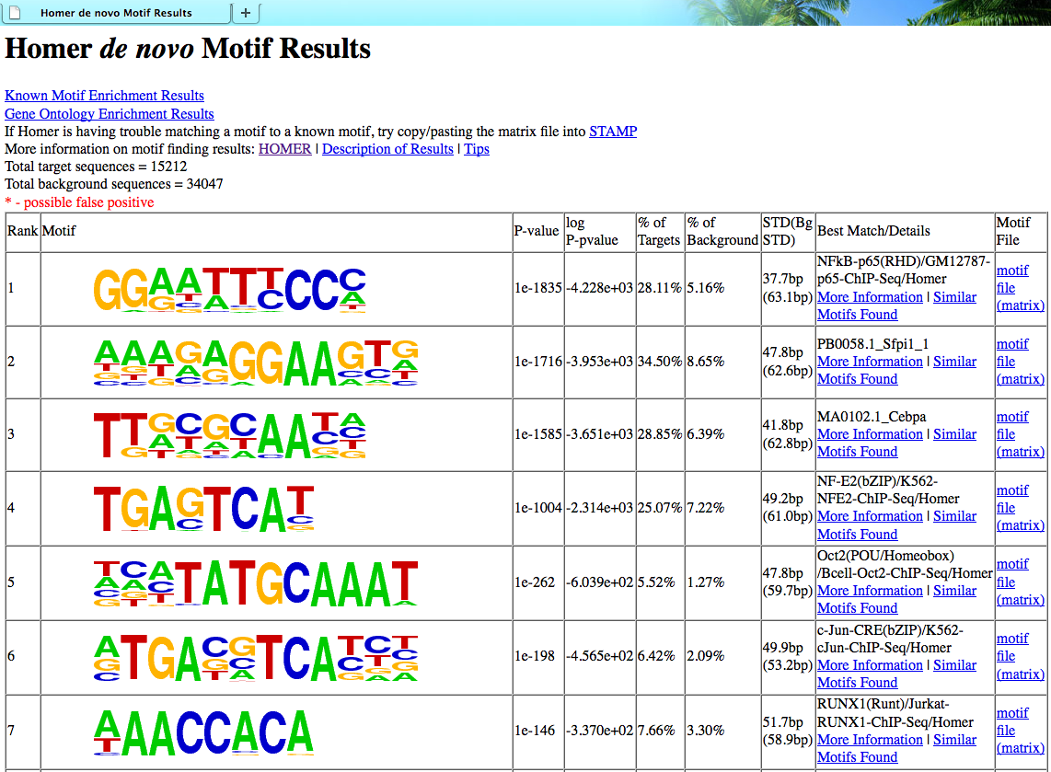
Interpreting the trained neural network
Prototype
GO Enrichment Analysis
Omics X cluster i
Omics Y cluster j
Trained Model
Black Box
Omics X cluster i
=
Omics Y cluster j
Activation maximization
KNN classifier Cluster match
Downstream Analysis
Cell type annotation using key features
Motif Analysis
Top K
Multi-omics key features for cell types
Key Features
……

Slide 37
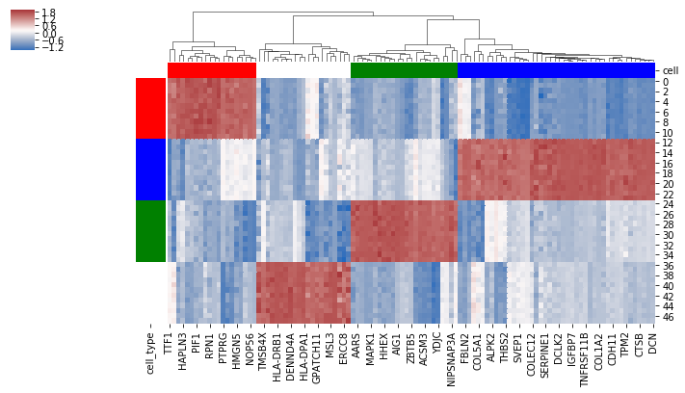
Prototype learned by NN is close to ground truth
Key genes found by the model
Key motifs found by the model
H1
IRF1
BJ
GATA1
K562
FRA1
GM12878
POU Homeobox

Slide 38
Prototype learned by NN is close to ground truth
Roadmap Epigenomics Cell and Tissue Gene Expression Profiles
Up-expressed genes of cell lines
Top 100 key genes of cell lines
AMANDA Activation Maximization

Slide 39
Limitations
Relies on Seurat anchors, which could be misleading

Slide 40
Limitations
Relies on Seurat anchors, which could be wrong
Interpretability is limited
Feature mapping is still unclear
Hard to generalize
Need efforts to fine-tune the model
Cannot be applied to another dataset
Not robust enough
Markers found by AM varies in each independent running of the model

Slide 41

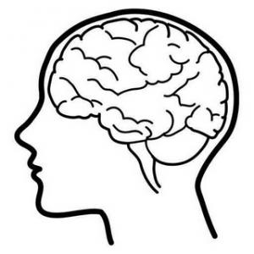
One-shot learning
Probability
N x
CNN
www.ibm.com/blogs/research/2019/01/diversity-in-faces/
…
A classic CNN needs to be trained all over again with large number of the face images
Human can recognize new faces even with few or one image

Slide 42
One-shot learning
Human
Probability
Similar?
N x
CNN
Similar?
…
…
Similarity measurement rather than classification
A classic CNN needs to be trained all over again with large number of the face images

Slide 43
One-shot learning
Human
Machine
Identical or not?
No
Similar?
Siamese Network
No
Similar?
Yes
…
…
…
Similarity measurement rather than classification
One-shot learning with Siamese network. The machine is trained to learn similarity measurement.

Slide 44
One-shot learning
One-shot learning in integration
Identical or not?
Cell i transcriptome
Siamese Network
No
Cell j chromatin accessibility
The Siamese network learns how to measure similarity between transcriptome and chromatin accessibility.

Slide 45
One-shot learning
One-shot learning in integration
Identical or not?
Cell i transcriptome
Siamese Network
Yes
Cell i chromatin accessibility
How to construct the Siamese network so that it can learn the feature mapping between the two omics?

Slide 46
One-shot learning
One-shot learning in integration
Identical or not?
Cell i transcriptome
Siamese Network
Yes
Cell i chromatin accessibility
How to construct the Siamese network so that it can learn the feature mapping between the two omics?
Position & Interaction

Slide 47
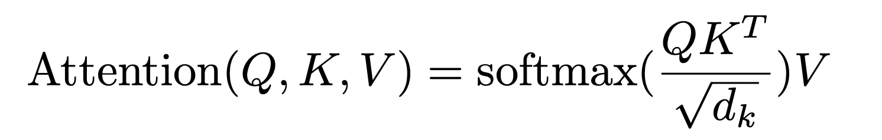
Self-Attention Mechanism to Detect Interaction
Query seq:
x W_{q} = Q
Key seq:
x W_{k} = K
Value seq:
x W_{v} = V
Reference: Attention is All You Need. arXiv:1706.03762

Slide 48
Self-Attention Mechanism to Detect Interaction
Output
1
2
3
4
1
=
2
x V
=
3
4
Long-term interaction such as enhancer-promoter will be learned
Reference: Attention is All You Need. arXiv:1706.03762

Slide 49
Specific Aim
Build a one-shot learning framework to
Train with ground truth labels (e.g. SNARE-seq dataset)
Map features between transcriptome and chromatin accessibility
Detect highly similar cells from different omics
Generate transcriptome data from chromatin accessibility for integration

Slide 50
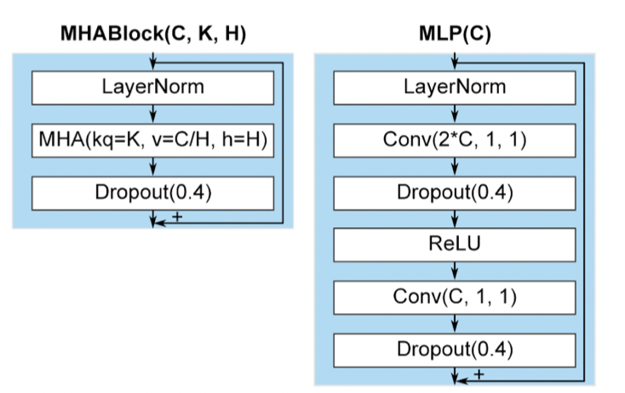
Model architecture
(N, 1)
Input ATAC-seq
Input RNA-seq
(G, 1)
Crop(M)
ConvBlock(C/64, F, D)
ConvBlock(C, 1, 1)
RConvBlock(C/64, 1, 1)
Dropout(p)
AttentionPool(width)
GELU
(N/width/2^{L2}-2M, C)
(N/width, C/64)
ConvBlock(G, 1, 1)
ConvBlock(Ci, F, D)
Feed Forward
C: number of channels
F: filter width
D: dilation rate
K: number of keys in MHA
H: number of attention heads
Li: number of layers
L₂ X
RConvBlock(Ci, 1, 1)
AttentionPool(width)
Output
(G, 1)
(N/width/2^{L2}, C)
MHABlock(C, K, H)
Feed Forward Layers
L₃ X
MLP(C)
Siamese Loss
(N/width/2^{L2}, C)
Reference: Žiga Avsec, et al. Effective gene expression prediction from sequence by integrating long-range interactions. bioRxiv 2021.

Slide 51
Define the APN trios for training
Cell_{j} from ATAC-seq
Huge size of training labels
10000 cells: 10000 * 9999 / 2 + 10000
Hard to generalize
high similarity
N
Cell_{i} from RNA-seq
P
Cell_{i} from ATAC-seq

Slide 52
Define the APN trios for training
Groups defined by KNN graph
2
Group_{j} from ATAC-seq
N
2
Group_{i} from RNA-seq
1
3
P
1
3
3
1
Group_{i} from ATAC-seq
*Neighbors are compensating each other for
undetected genes due to the sparsity

Slide 53
Performance Evaluation
Identity accuracy: whether identical cells from RNA-seq and ATAC-seq are predicted to be identical
Label transfer accuracy
Silhouette score: how well
Clusters are separated
Modalities are merged

Slide 54
Thanks for your time!
Any suggestions?
Chaozhong Liu
Supervisor: Dr. Zhandong Liu
Program: Quantitative and Computational Biosciences

